Slide 1
Chapter 5
SQL: Advanced Queries, Assertions, Triggers, and Views

Slide 2
Manipulating DB by using SQL
…
AP
DBA
construct
DML
manipulate
1. Define DB
(SQL DDL)
2. Load data
DB
User
DB System
SQL (Ch.4, 5)
Data Manipulation Language
Query: SELECT
Update: INSERT, DELETE, UPDATE
SQL (Ch.4)
Data Definition Language
- CREATE, DROP, ALTER

Slide 3
Chapter Outline
SQL Data Definition and Data Types
Specifying Constraints in SQL
Basic Retrieval Queries in SQL
INSERT, DELETE, and UPDATE Statements in SQL
More Complex SQL Queries
Specifying Constraints as Assertions and triggers
Views (Virtual Tables) in SQL
Schema Change Statements in SQL

Slide 4
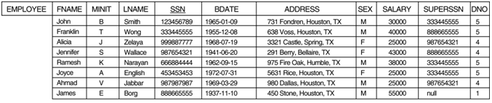
NULLS IN SQL QUERIES
SQL allows queries that check if a value is NULL (missing or undefined or not applicable)
SQL uses IS or IS NOT to compare NULLs because it considers each NULL value distinct from other NULL values, so equality comparison is not appropriate .
Query 14: Retrieve the names of all employees who do not have supervisors.
Q14: SELECT FNAME, LNAME FROM EMPLOYEE WHERE SUPERSSN IS NULL

Slide 5
NESTING OF QUERIES
A complete SELECT query, called a nested query , can be specified within the WHERE-clause of another query, called the outer query
Many of the previous queries can be specified in an alternative form using nesting
Query 1: Retrieve the name and address of all employees who work for the ‘Research’ department. Q1N: SELECT FNAME, LNAME, ADDRESS FROM EMPLOYEE WHERE DNO IN (SELECT DNUMBER FROM DEPARTMENT WHERE DNAME='Research' )
DNUMBER
5
Q1: SELECT FNAME, LNAME, ADDRESS FROM EMPLOYEE, DEPARTMENT WHERE DNAME='Research' AND NUMBER=DNO

Slide 6

NESTING OF QUERIES (cont.)
The nested query selects the number of the 'Research' department
The outer query select an EMPLOYEE tuple if its DNO value is in the result of either nested query
The comparison operator IN compares a value v with a set (or multi-set) of values V, and evaluates to TRUE if v is one of the elements in V
In general, we can have several levels of nested queries
A reference to an unqualified attribute refers to the relation declared in the innermost nested query
In this example, the nested query is not correlated with the outer query

Slide 7
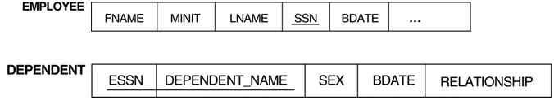
CORRELATED NESTED QUERIES
If a condition in the WHERE-clause of a nested query references an attribute of a relation declared in the outer query , the two queries are said to be correlated
The result of a correlated nested query is different for each tuple (or combination of tuples) of the relation(s) the outer query
Query 16: Retrieve the name of each employee who has a dependent with the same first name as the employee. Q16: SELECT E.FNAME, E.LNAME FROM EMPLOYEE AS E WHERE E.SSN IN (SELECT ESSN FROM DEPENDENT WHERE ESSN = E.SSN AND E.FNAME = DEPENDENT_NAME)
E.SSN: 123
ESSN
123
E
Tom
Mary
123
285
123
285
Tom
John
M
M

Slide 8
CORRELATED NESTED QUERIES
In Q12, the nested query has a different result for each tuple in the outer query
A query written with nested SELECT... FROM... WHERE... blocks and using the = or IN comparison operators can always be expressed as a single block query.
For example, Q12 may be written as in Q12A
Q12A: SELECT E.FNAME, E.LNAME FROM EMPLOYEE E, DEPENDENT D WHERE E.SSN = D.ESSN AND E.FNAME = D.DEPENDENT_NAME
E
Tom
Mary
123
285
123
285
Tom
John
M
M

Slide 9
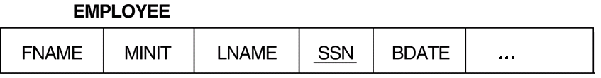
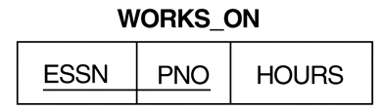
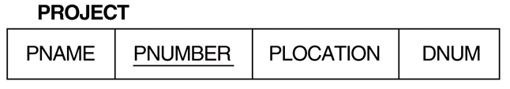
CORRELATED NESTED QUERIES
Most implementations of SQL do not have this operator
The CONTAINS operator compares two sets of values , and returns TRUE if one set contains all values in the other set (reminiscent of the division operation of algebra).
Query 3: Retrieve the name of each employee who works on all the projects controlled by department number 5.
Q3: SELECT FNAME, LNAME FROM EMPLOYEE WHERE ( (SELECT PNO FROM WORKS_ON WHERE SSN=ESSN) CONTAINS (SELECT PNUMBER FROM PROJECT WHERE DNUM=5) )
123
285
PNO
9
2
7
PNO
6
9
2
PNUMBER
9
2
123
123 9
9 5

Slide 10
CORRELATED NESTED QUERIES (cont.)
In Q3, the second nested query, which is not correlated with the outer query, retrieves the project numbers of all projects controlled by department 5
The first nested query, which is correlated, retrieves the project numbers on which the employee works, which is different for each employee tuple because of the correlation

Slide 11
THE EXISTS FUNCTION (cont.)
EXISTS is used to check whether the result of a correlated nested query is empty (contains no tuples) or not
We can formulate Query 12 in an alternative form that uses EXISTS as Q12B below
Query 12: Retrieve the name of each employee who has a dependent with the same first name as the employee.
Q12B: SELECT FNAME, LNAME FROM EMPLOYEE WHERE EXISTS ( SELECT * FROM DEPENDENT WHERE SSN = ESSN AND FNAME = DEPENDENT_NAME)
Tom
123
123
Tom

Slide 12
THE EXISTS FUNCTION
Query 6: Retrieve the names of employees who have no dependents. Q6: SELECT FNAME, LNAME FROM EMPLOYEE WHERE NOT EXISTS ( SELECT * FROM DEPENDENT WHERE SSN=ESSN)
In Q6, the correlated nested query retrieves all DEPENDENT tuples related to an EMPLOYEE tuple. If none exist , the EMPLOYEE tuple is selected
EXISTS is necessary for the expressive power of SQL
123

Slide 13
EXPLICIT SETS
It is also possible to use an explicit (enumerated) set of values in the WHERE-clause rather than a nested query
Query 17: Retrieve the social security numbers of all employees who work on project number 1, 2, or 3.
Q17: SELECT DISTINCT ESSN FROM WORKS_ON WHERE PNO IN (1, 2, 3)
123 2
9
285 9
310 1
310 3
… …

Slide 14


Joined Relations Feature in SQL2
Can specify a "joined relation" in the FROM-clause
Looks like any other relation but is the result of a join
Allows the user to specify different types of joins (regular "theta" JOIN, NATURAL JOIN, LEFT OUTER JOIN, RIGHT OUTER JOIN, CROSS JOIN, etc)
Q2: SELECT PNUMBER, DNUM, LNAME, BDATE, ADDRESS FROM ((PROJECT JOIN DEPARTMENT ON DNUM=DNUMBER)
JOIN EMPLOYEE ON MGRSSN=SSN) ) WHERE PLOCATION='Stafford’
Stafford
7
7
293
293

Slide 15

Joined Relations Feature in SQL2 (cont.)
Q1: SELECT FNAME, LNAME, ADDRESS FROM EMPLOYEE, DEPARTMENT WHERE DNAME='Research' AND DNUMBER=DNO
could be written as:
Q1: SELECT FNAME, LNAME, ADDRESS FROM (EMPLOYEE JOIN DEPARTMENT ON DNUMBER=DNO) WHERE DNAME='Research’
=
Equal-Join

Slide 16


Natural Join
Q1: SELECT FNAME, LNAME, ADDRESS FROM (EMPLOYEE JOIN DEPARTMENT ON DNUMBER=DNO) WHERE DNAME='Research’
or as:
Q1: SELECT FNAME, LNAME, ADDRESS FROM (EMPLOYEE NATURAL JOIN DEPARTMENT AS DEPT(DNAME, DNO, MSSN, MSDATE) WHERE DNAME='Research’
=
Natural Join: 問題:Left outer join 跟 natural join?
1. Equal-Join on the attributes with the same name.
2. Eliminate the redundant attribute.
redundant
=

Slide 17
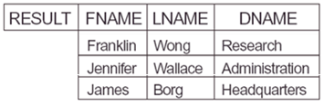

Deficiency of JOIN Operation
To find the employees who are manager and the department which they manage.
SELECT FNAME, LNAME, DNAME FROM EMPLOYEE DEPARTMENT WHERE MGRSSN = SSN
How about to include all the employees who are manager and not managers?
8 tuples
MGRSSN=SSN
3 tuples

Slide 18
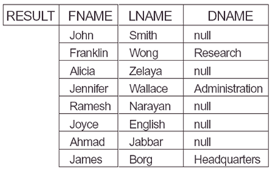
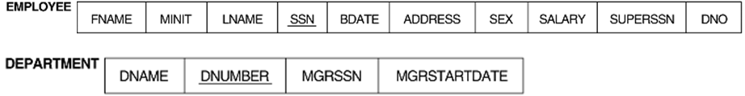
Left Outer Join Operation
A list of all employee names and also the name of the departments they manage if they happen to manage a department;
Apply an operation LEFT OUTER JOIN, denoted by , to retrieve the result as follows:
SELECT FNAME, LNAME, DNAME
FROM (EMPLOYEE LEFT OUTER JOIN DEPARTMENT ON MGRSSN=SSN)
3 tuples
8 tuples
8 tuples
3 tuples

Slide 19
Outer Join
Allows the user to specify different types of joins (regular "theta" JOIN, NATURAL JOIN, LEFT OUTER JOIN, RIGHT OUTER JOIN, CROSS JOIN, etc)
Examples: To include all the employees who are manager and not managers.
SELECT FNAME, LNAME, DNAME
FROM (EMPLOYEE LEFT OUTER JOIN DEPARTMENT ON MGRSSN=SSN)
SELECT FNAME, LNAME, DNAME
FROM (DEPARTMENT RIGHT OUTER JOIN EMPLOYEE ON MGRSSN=SSN)
8 tuples
3 tuples

Slide 20
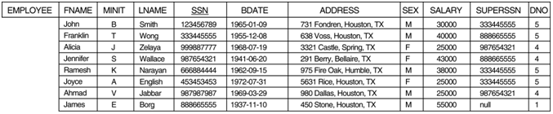
AGGREGATE FUNCTIONS
The type of previous queries:
SELECT FNAME, LNAME, ADDRESS FROM EMPLOYEE WHERE DNO = 5
How about the following queries:
How many employees in the company?
What is the average, minimum, and maximum salary in each department?
For each department in which more than two employees work, retrieve their total salary in the department.

Slide 21
AGGREGATE FUNCTIONS 集合
Include COUNT, SUM, MAX, MIN, and AVG
Query 15:
Find the maximum salary, the minimum salary, and the average salary among all employees.
Q15: SELECT MAX(SALARY), MIN(SALARY), AVG(SALARY) FROM EMPLOYEE
Some SQL implementations may not allow more than one function in the SELECT-clause
Query 16:
Find the maximum salary, the minimum salary, and the average salary among employees who work for the 'Research' department.
Q16: SELECT MAX(SALARY), MIN(SALARY), AVG(SALARY) FROM EMPLOYEE, DEPARTMENT WHERE DNO=DNUMBER AND DNAME='Research'
Maximum salary?

Slide 22
AGGREGATE FUNCTIONS (cont.)
Queries 17 and 18: Retrieve the total number of employees in the company (Q17), and the number of employees in the 'Research' department (Q18). Q17: SELECT COUNT (*) FROM EMPLOYEE Q18: SELECT COUNT (*) FROM EMPLOYEE, DEPARTMENT WHERE DNO=DNUMBER AND DNAME='Research’
5
How many employees?
How many employees in Research Department?
Research
5

Slide 23
GROUPING
In many cases, we want to apply the aggregate functions to subgroups of tuples in a relation
Each subgroup of tuples consists of the set of tuples that have the same value for the grouping attribute(s)
The function is applied to each subgroup independently
SQL has a GROUP BY-clause for specifying the grouping attributes, which must also appear in the SELECT-clause
How many employees in each department?

Slide 24
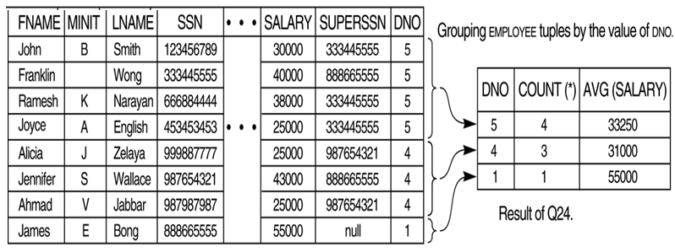
GROUPING (cont.)
Query 24: For each department, retrieve the department number, the number of employees in the department, and their average salary. Q24: SELECT DNO, COUNT (*), AVG (SALARY) FROM EMPLOYEE GROUP BY DNO
the EMPLOYEE tuples are divided into groups--each group having the same value for the grouping attribute DNO
The COUNT and AVG functions are applied to each such group of tuples separately
The SELECT-clause includes only the grouping attribute and the functions to be applied on each group of tuples

Slide 25


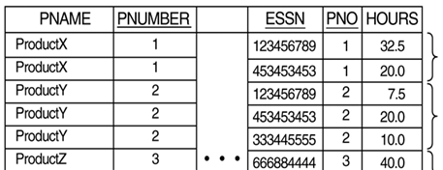
GROUPING (cont.)
Query 21: For each project, retrieve the project number, project name, and the number of employees who work on that project. Q21: SELECT PNUMBER, PNAME, COUNT(*) FROM PROJECT, WORKS_ON WHERE PNUMBER=PNO GROUP BY PNUMBER, PNAME
In this case, the grouping and functions are applied after the joining of the two relations

Slide 26
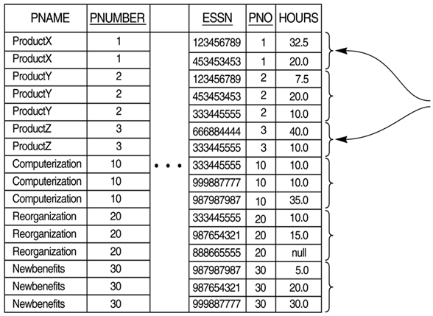


THE HAVING-CLAUSE
To retrieve the values of these functions for only those groups that satisfy certain conditions
The HAVING-clause is used for specifying a selection condition on groups (rather than on individual tuples)
Q26: For each project on which more than two employees work, retrieve the project number, project name, and the number of employees who work on that project.
Q26: SELECT PNUMBER, PNAME, COUNT(*) FROM PROJECT, WORKS_ON WHERE PNUMBER=PNO GROUP BY PNUMBER, PNAME HAVING COUNT(*) > 2
PNUMBER = PNO
GROUP BY PNUMBER, PNAME

Slide 27
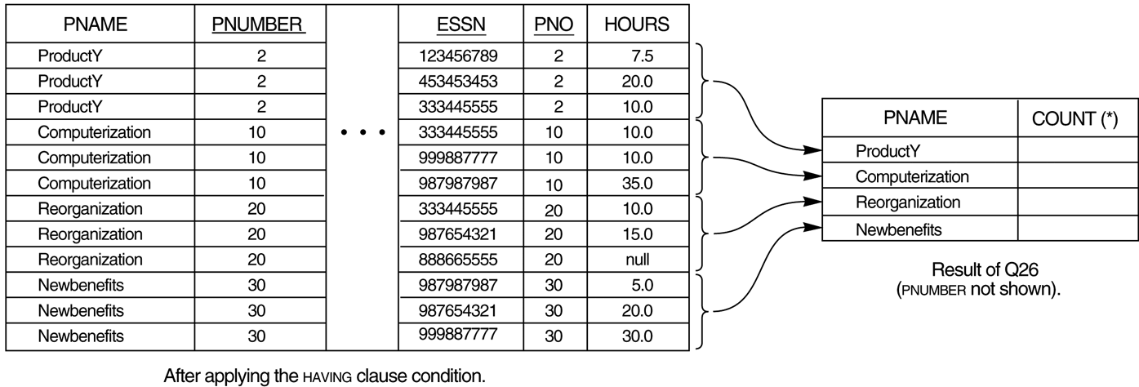
FIGURE 8.6 Results of GROUP BY and HAVING. (b) Q26.
COUNT (*) > 2
Q26: SELECT PNUMBER, PNAME, COUNT(*) FROM PROJECT, WORKS_ON WHERE PNUMBER=PNO GROUP BY PNUMBER, PNAME HAVING COUNT(*) > 2

Slide 28
Summary of SQL Queries
A query in SQL can consist of up to six clauses, but only the first two, SELECT and FROM, are mandatory. The clauses are specified in the following order:
SELECT <attribute list> FROM <table list> [WHERE <condition>] [GROUP BY <grouping attribute(s)>] [HAVING <group condition>] [ORDER BY <attribute list>]
A query is evaluated by first applying the WHERE-clause, then GROUP BY and HAVING, and finally the SELECT-clause.

Slide 29
Summary of SQL Queries (cont.)
The SELECT-clause lists the attributes or functions to be retrieved
The FROM-clause specifies all relations (or aliases) needed in the query but not those needed in nested queries
The WHERE-clause specifies the conditions for selection and join of tuples from the relations specified in the FROM-clause
GROUP BY specifies grouping attributes
HAVING specifies a condition for selection of groups
ORDER BY specifies an order for displaying the result of a query

Slide 30
Constraints as Assertions
General constraints:
constraints that do not fit in the basic SQL categories
e.g. key constraint, entity constraint, referential integrity constraint.
Mechanism:
CREAT ASSERTION
components include: a constraint name, followed by CHECK, followed by a condition
The salary of an employee must not be greater than the salary of the manager of the department that the employee works for.

Slide 31
Assertions: An Example
Constraint:
The salary of an employee must not be greater than the salary of the manager of the department that the employee works for.
CREATE ASSERTION SALARY_CONSTRAINT
CHECK (NOT EXISTS (SELECT *
FROM EMPLOYEE E, EMPLOYEE M, DEPARTMENT D
WHERE E.SALARY > M.SALARY AND
E.DNO=D.NUMBER AND D.MGRSSN=M.SSN))
Specify a query that violates the condition; include inside a NOT EXISTS clause
Query result must be empty
if the query result is not empty, the assertion has been violated

Slide 32
SQL Triggers
To monitor a database and take action when a condition occurs
Triggers are expressed in a syntax similar to assertions and include the following:
event (e.g., an update operation)
condition
action (to be taken when the condition is satisfied)
A trigger to compare an employee’s salary to his/her supervisor during insert or update operations:
CREATE TRIGGER INFORM_SUPERVISOR
BEFORE INSERT OR UPDATE OF
SALARY, SUPERSSN ON EMPLOYEE
FOR EACH ROW
WHEN
(NEW.SALARY > (SELECT SALARY
FROM EMPLOYEE
WHERE SSN = NEW.SUPERSSN))
INFORM_SUPERVISOR (NEW.SUPERSSN,NEW.SSN);
886
886
997
30000 997 (original)
40000 997 (NEW)
38000 123
update →

Slide 33
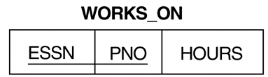
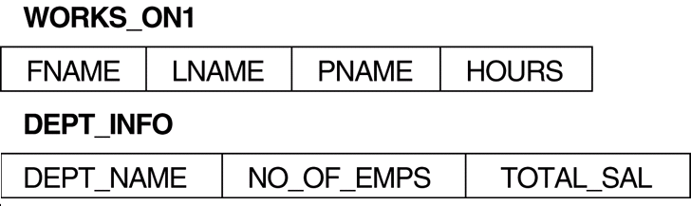
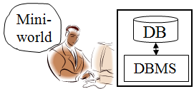
Views in SQL
A view is a “virtual” table that is derived from other tables (base tables or other virtual tables)
Allows full query operations
Allows for limited update operations (since the table may not physically be stored)
A convenience for expressing certain operations
Two views specified on the database schema
Base tables
Names of employees working on the project ProductX?

Slide 34

SQL Views: An Example
Specify a different WORKS_ON table
CREATE VIEW WORKS_ON1
AS SELECT FNAME, LNAME, PNAME, HOURS
FROM EMPLOYEE, PROJECT, WORKS_ON
WHERE SSN=ESSN AND PNO=PNUMBER;
We can specify SQL queries on a newly create table (view):
SELECT FNAME, LNAME
FROM WORKS_ON1
WHERE PNAME=‘ProjectX’;
When no longer needed, a view can be dropped:
DROP WORKS_ON1;

Slide 35
Specification of Views
SQL command: CREATE VIEW
a table (view) name
a possible list of attribute names, e.g.,
(when arithmetic operations are specified or
when we want the names to be different from the attributes in the base relations)
a query to specify the table contents
CREATE VIEW DEPT_ INFO(DEPT_NAME, NO_OF_EMPS, TOTAL_SAL)
AS SELECT DNAME, COUNT(*), SUM(SALARY)
FROM DEPARTMENT, EMPLOYEE
WHERE DNUMBER=DNO
GROUP BY DNAME;

Slide 36



Two View Implementations
DBMS
User’s View
Query modification
Base tables
SELECT FNAME, LNAME
FROM WORKS_ON1
WHERE PNAME=‘ProjectX’;
View
Query a view
Base tables
View
materialize

Slide 37
Query Modification
SELECT FNAME, LNAME
FROM WORKS_ON1 // view
WHERE PNAME=‘ProjectX’;
SELECT FNAME, LNAME
FROM EMPLOYEE, PROJECT, WORKS_ON //base tables
WHERE SSN=ESSN AND PNO=PNUMBER AND PNAME=‘ProjectX’
Query modification
to base tables

Slide 38
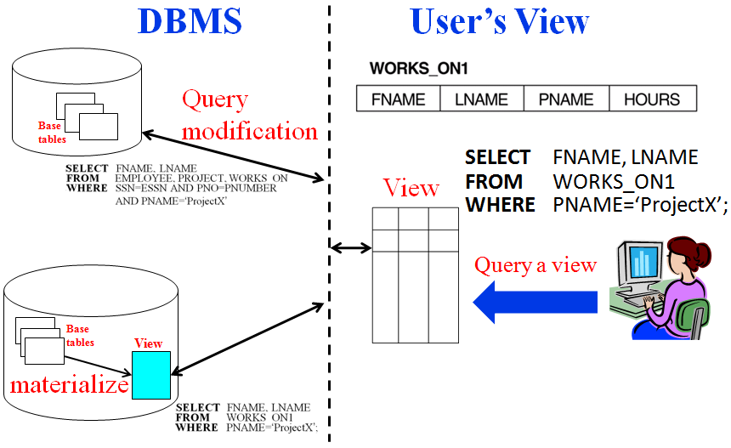
Efficient View Implementation
Query modification:
present the view query in terms of a query on the underlying base tables
disadvantage: inefficient for views defined via complex queries (especially if additional queries are to be applied to the view within a short time period)
View materialization:
involves physically creating and keeping a temporary table
assumption: other queries on the view will follow
concerns: maintaining correspondence between the base table and the view when the base table is updated
strategy: incremental update

Slide 39

View Update
Update on a single view is possible if the view attributes contain
the Primary Key of the base relation, and
as all attributes with the NOT NULL constraint that do not have default values specified.
WITH CHECK OPTION:
must be added to the definition of a view if the view is to be updated
to allow check for updatability and to plan for an execution strategy
Base table
P.K.
view
define
view
P.K.
update
view

Slide 40
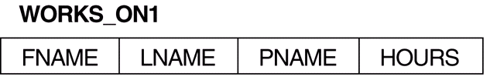
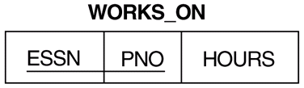
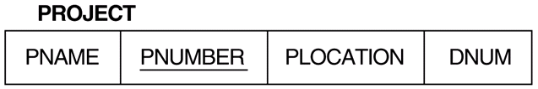
Un-updatable Views
UPDATE WORKS_ON1
SET PNAME=‘ProductY’
WHERE LNAME=‘Smith’ AND FNAME=‘John’ AND PNAME=‘ProductX’;
View:
update
update?
Base relations:
join

Slide 41
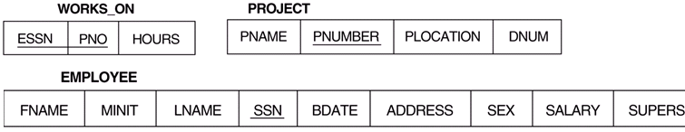
Two Possible Modifications
UPDATE WORKS_ON
SET PNO = (SELECT PNUMBER
FROM PROJECT
WHERE PNAME=‘ProjectY’)
WHERE ESSN IN (SELECT SSN
FROM EMPLOYEE
WHERE LNAME=‘Smith’ AND FNAME=‘John’)
AND
PNO = (SELECT PNUMBER
FROM PROJECT
WHERE PNAME=‘ProductX’);
UPDATE PROJECT SET PNAME=‘ProductY’
WHERE PNAME=‘ProductX’;

Slide 42
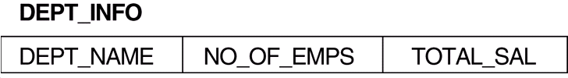
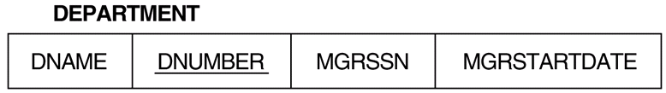
Un-updatable Views
Views defined using groups and aggregate functions are not updateable
UPDATE DEPT_INFO
SET TOTAL_SAL=100000
WHERE DNAME=‘Research’
update
View:
update?
Base table:

Slide 43
DROP TABLE
Used to remove a relation (base table) and its definition
The relation can no longer be used in queries, updates, or any other commands since its description no longer exists
Example: DROP TABLE DEPENDENT;

Slide 44
ALTER TABLE
Used to add an attribute to one of the base relations
The new attribute will have NULLs in all the tuples of the relation right after the command is executed; hence, the NOT NULL constraint is not allowed for such an attribute
Example: ALTER TABLE EMPLOYEE ADD JOB VARCHAR(12);
The database users must still enter a value for the new attribute JOB for each EMPLOYEE tuple. This can be done using the UPDATE command.

Slide 45
關於考試
會有英文題目
會考考古題及網路學園內的自我評量
會考SQL
不能帶任何字典
不能使用鉛筆作答
手機關機且不可放在桌面

